Slide 1
ENDOCRINE SYSTEM
PANCREASE

Slide 2
pancreas
pancreas is a gland organ
it is located interior of the abdomen.
the organ is approximate 6 to 8 inches long. it extend horizontal across the abdomen.
the largest part lies outside the abdomen where stomach attaché to small intestine and duodenum
the organ is part of endocrine system.

Slide 3
Anatomy of the pancreas
the pancreas is an elongated ,tapered organ located across the back of the belly, just behind the stomach.
the right hand side(the head) is the widest part of the organ and lies in the curves of the duodenum.
the tapered left side extend slightly up and is called the body of the pancreases. it ends near the spleen(the tail)

Slide 4
Anatomical description of Pancreas
Pancreas is approximately 6 inches long
It sit behind the stomach
Found across the back of the abdomen
It has a shape of an Oblong
It is an elongated organ
It is pinkish in color or light tan

Slide 5
Anatomy of the pancreas(cont…
the organ is divided into two glands
1. exocrine
the grand secrete digestive enzymes the enzymes are secreted in network of duct that joins pancreatic duct
.
2. endocrine
the endocrine grand contains islets of Langerhans and secrete hormone into the bloodstream.

Slide 6
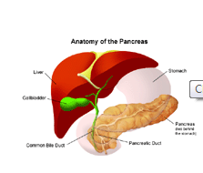
Anatomy of the pancreas(cont…

Slide 7
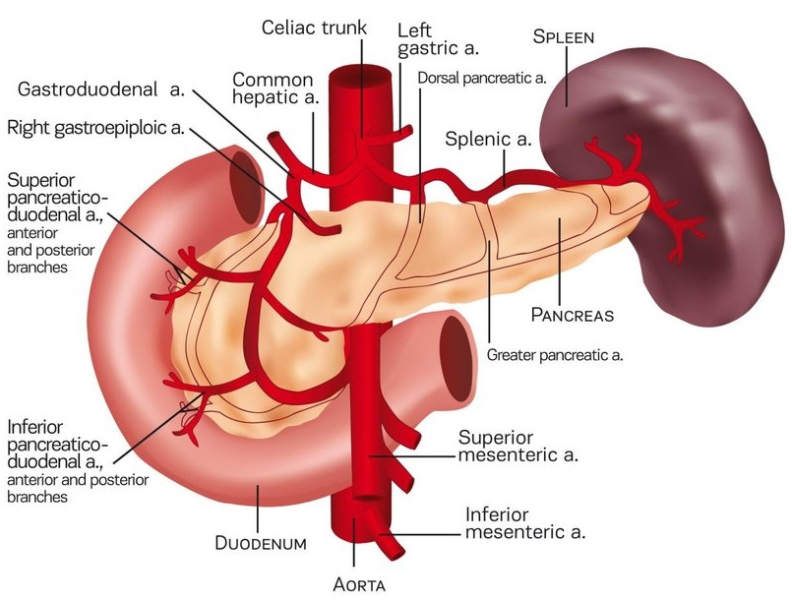
Anatomical position picture of pancreas

Slide 8
Cell and tissues types for pancreases
the endocrine part of the organ takes many small cluster cells called islets of Langerhans.
they house three major types of cells
1. alpha cells(a cells). the cells secrete hormone glucagon
2. beta cells(b cells) they produces insulin's and are most abundant of the islet of Langerhans cells
delta cells(d cells). the cells secrete the hormone somatostatin. the hormone is also produced by number of endocrine cells in the body.

Slide 9
Cell and tissues types for pancreases (cont…
other pancreas cells includes
1. gamma cells. the cells produces pancreatic polypeptide. this regulates both endocrine and exocrine pancreas secretions.
2. epsilon cells . they produces ghrelin and make up less than 1% of the total pancreases cells. ghrelin is a protein that stimulate hunger.
pancreas reveals two different types of parenchymal tissues:
exocrine acini duct and the endocrine islet of the langerhans.

Slide 10
Functions of pancreas
A healthy pancreas perform two kind of function in the human body
First exocrine tissues secrete a clear, watery, alkaline juice that contain several enzymes.
These enzymes are used in food break down which are absorbable in the intestines.
the enzymes includes
i. trypsin and chymotrypsin that digest proteins
Ii. Amylase that digest carbohydrates
Iii.lipase that digest fatty acids an cholesterol.
.

Slide 11
Functions of pancreas(cont.)
Second endocrine portion secrete insulin and other hormone
When blood sugar is high beta cells secrete insulin to regulate blood sugar.
When blood sugar lower alpha cells secrets glucagon. The hormone breaks down glycogen into glucose in the liver.

Slide 12
Role of pancreas in homeostasis
Pancreas play a major role in energy homeostasis.
this is done possible by releasing digestive enzymes and pancreatic hormones.
Majority of pancreas secretions consist of acinar (exocrine ). The cells contain digestive enzymes.
During prolonged fasting, pancreas produces glucagon. The enzymes drives hepatic and renal gluconeogenesis to maintain blood sugar.
in contrast to this insulin is secreted to lower the blood sugar when it rises beyond normal levels.

Slide 13
Homeostasis disorders of pancreas
Glucose balance play a major role in brain energy metabolism. However, if the pancreas fail in hemostasis the following disorders are very common.
Hypoglycemia. This is due to defect of hormone and enzymes of glucose regulation. This will result to inadequate supply of glucose or surplus of insulin.
The other disorder is called diabetes mellitus. This is as a result of complete or partial insulin deficiency.

Slide 14
Pancreas diseases
1. pancreas pain
This is an intensive pain usually associated with acute pancreatitis.
It is hard to notice the pancreas pain, however, there some of its symptoms which include itchy skin, jaundice and unexplained weight loss
2. pancreatitis.
this is an inflammation of the organ.
It happen when digestive enzymes start digesting the pancreases itself. The disease can be both acute or chronic.

Slide 15
Pancreas diseases(cont…
3. pancreas cancer
It is hard to diagnose pancreas cancer
according to America Cancer society it is very hard to identify tumor until the cancer stage is at advanced stage.
risk factor to pancreas cancer includes smoking, long term diabetes and chronic pancreatitis.
Some of the anatomic change of the pancreas due to cancer include tumor and hardening of the pancreas tissues.
Treatment option include surgery and chemotherapy.

Slide 16
Pancreas in digestive system
as earlier said pancreas is involved only in two body systems
these includes endocrine system and digestive system.
as a digestive system member, pancreases got a key role to play.
pancreas secret enzymes that works together with bile from live to breakdown food substance into absorbable materials.

Slide 17
Pancreas in digestive system(cont..
pancreas is a member of large digestive system that begins at the mouth.
it produces enzymes as soon as food reaches stomach.
these enzymes travel through a series o duct until it reaches the main pancreatic duct
The main duct meet bile from the liver in a process called ampulla of vater
Bile plus pancreas enzyme digest fats in the duodenum.

Slide 18
How to keep pancreas healthy
eating diet with low fat contents.
Lose weight and stay fit. Make a lot of physical exercises.
Don’t follow diet that promise quick weight loss. This will prevent liver from accumulation a lot of fat.
Avoid too much of alcohol.
Don’t smoke or use tobacco product.

Slide 19
References
Coate, K. C., Hernandez, G., Thorne, C. A., Sun, S., Le, T. D., Vale, K., ... & Mangelsdorf, D. J. (2017). FGF21 is an exocrine pancreas secretagogue. Cell metabolism, 25(2), 472-480.
Kitano, Y., Imazawa, M., Suzuki, Y., Yamakita, K., Iwamoto, H., Takahashi, K., ... & Ota, T. (2019). Our second autopsy case of autoimmune pancreatitis: A case report.
Röder, P. V., Wu, B., Liu, Y., & Han, W. (2016). Pancreatic regulation of glucose homeostasis. Experimental & molecular medicine, 48(3), e219-e219.
Wang, K., Wang, A. Z., & Tepper, J. E. (2018). Pancreas Cancer. In Hypofractionated and Stereotactic Radiation Therapy (pp. 285-295). Springer, Cham.

